Slide 1
Smart Aquarium
Devin Benninghoven, Jake Watson, Aren Ashikian

Slide 2
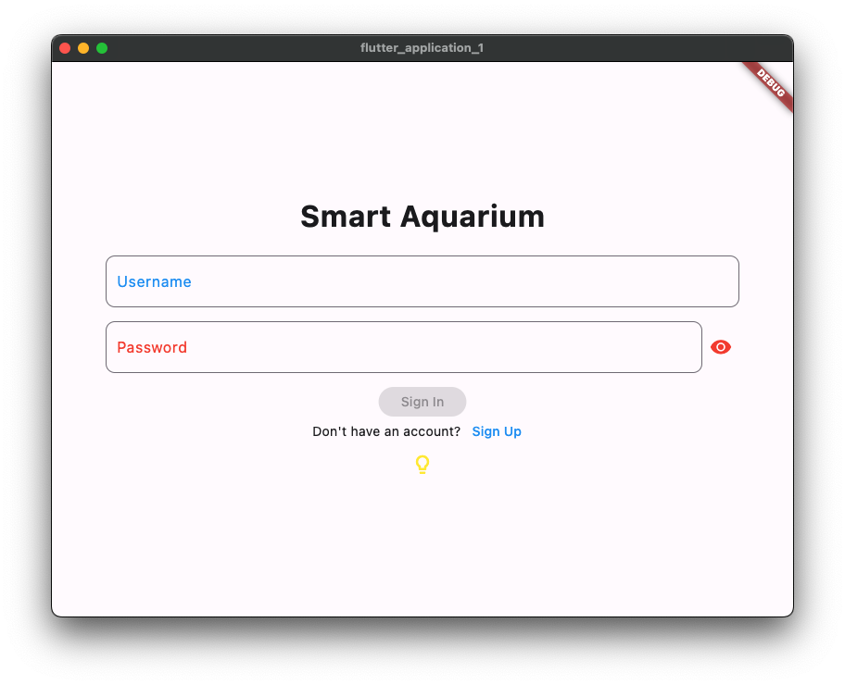
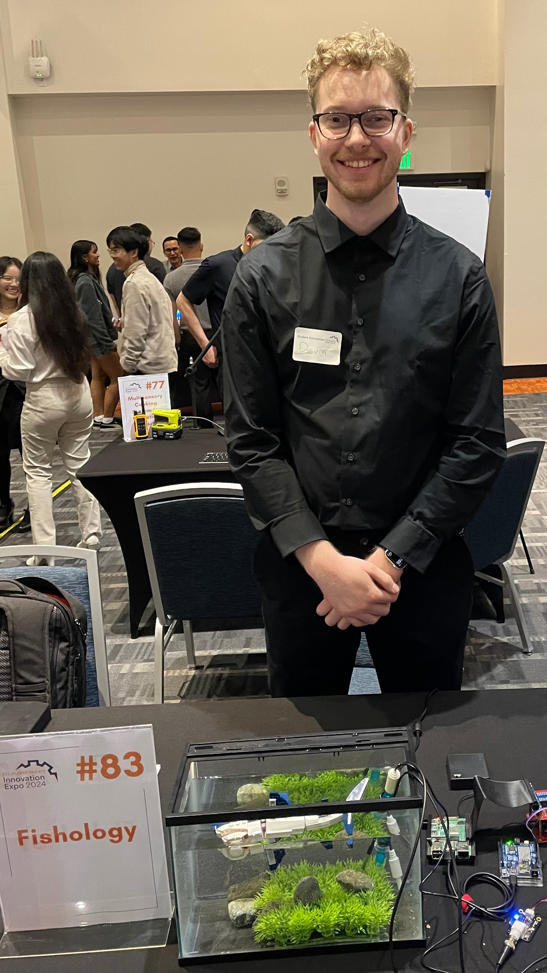
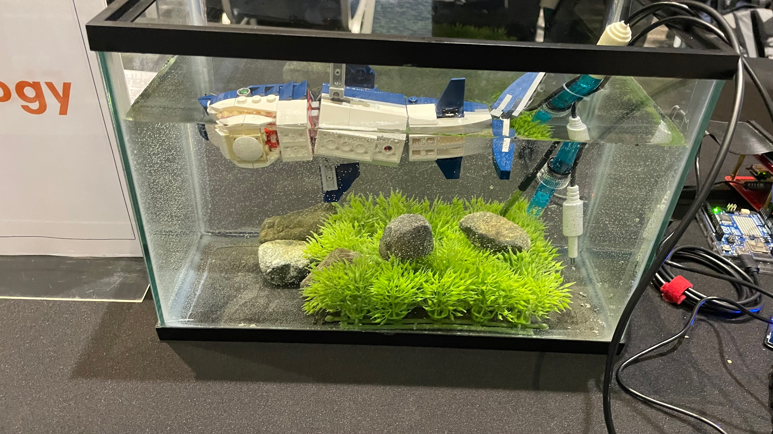

Slide 3
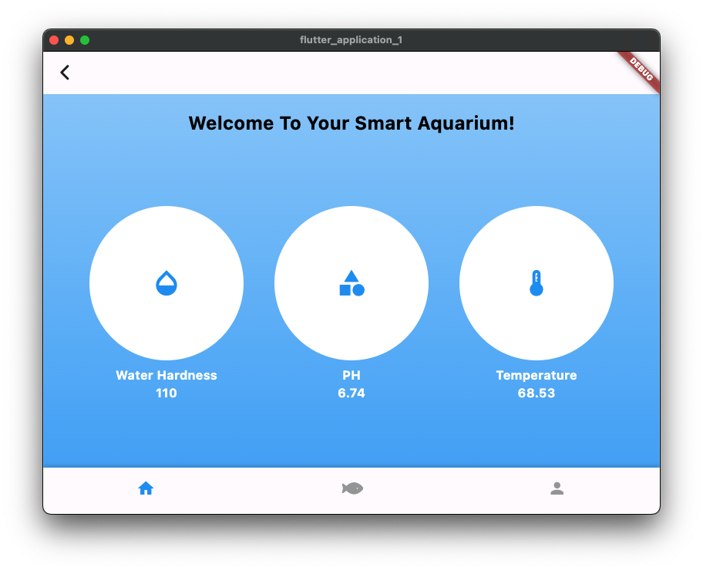
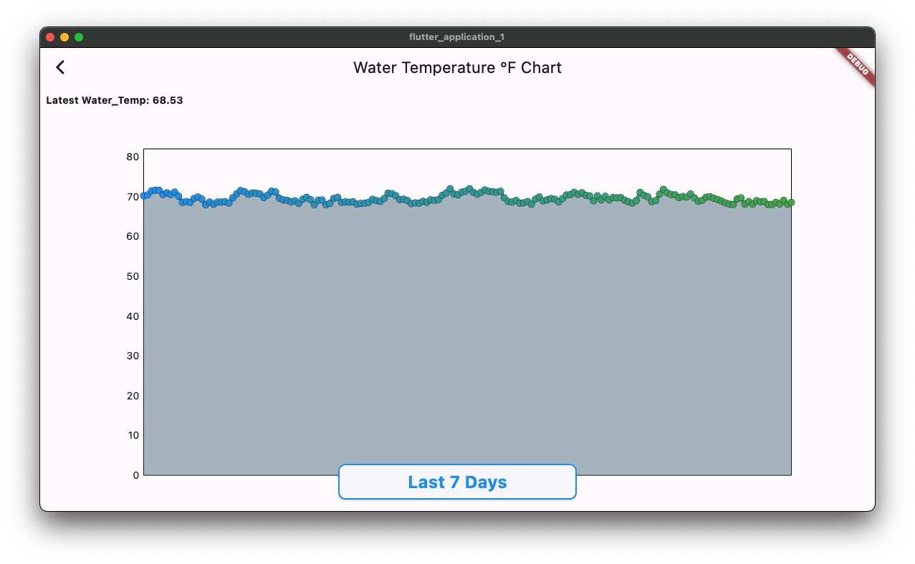
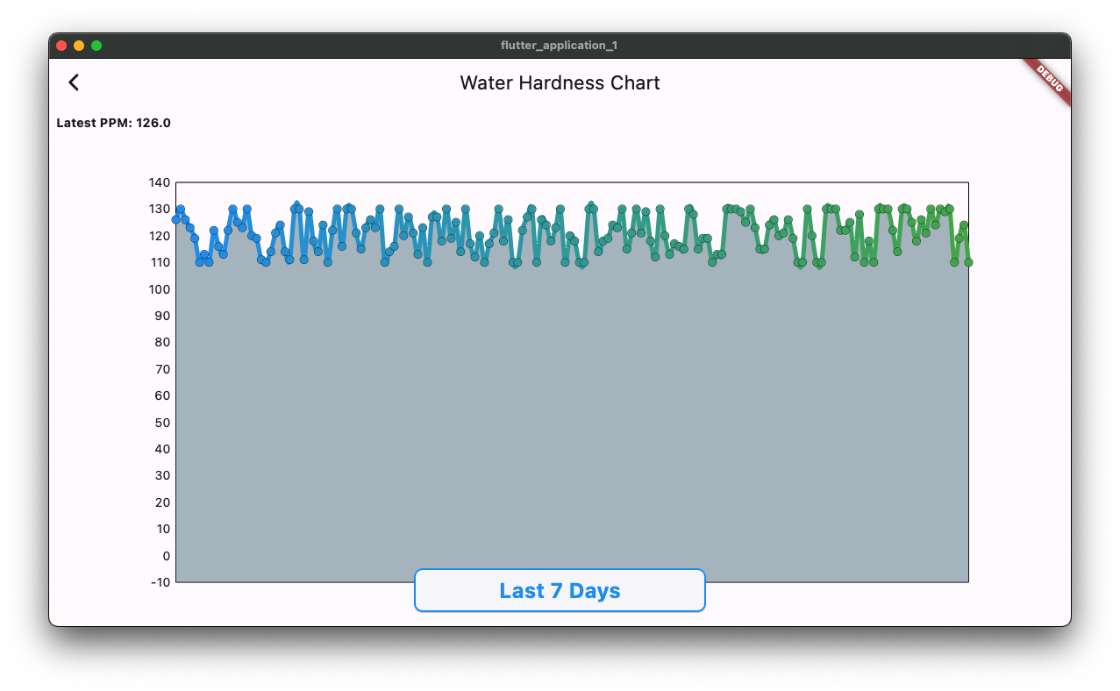
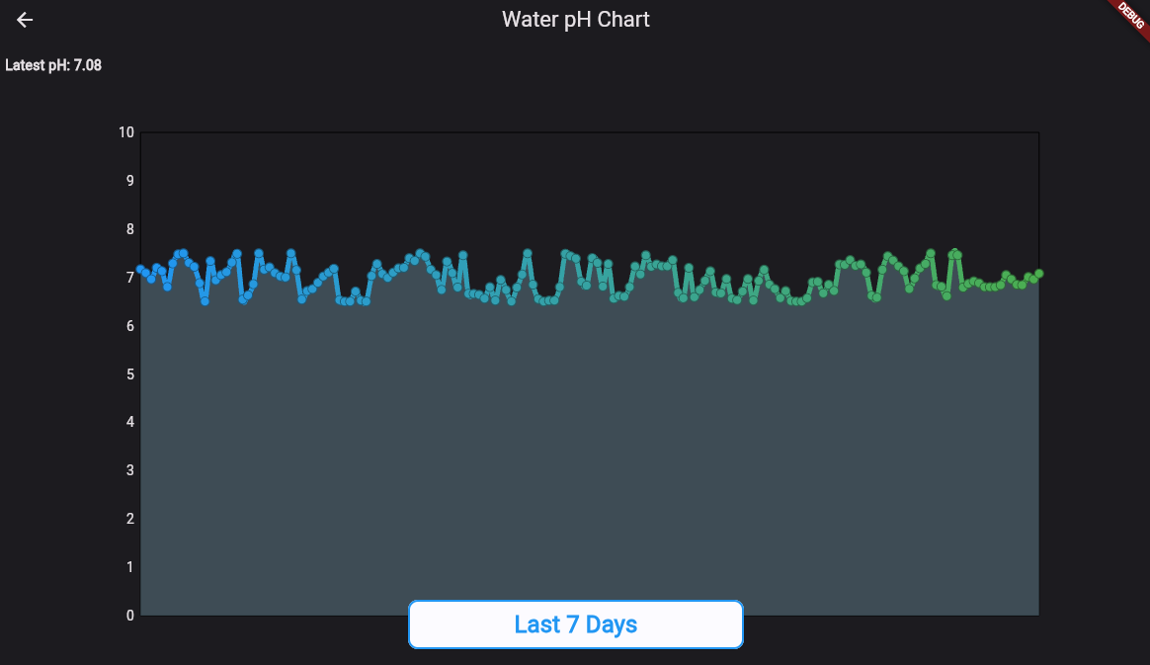

Slide 4
Results:
The project works as originally set out in the requirements and specifications, and delivers sensor data over the network to users in a timely manner.
Special Thank you to Professor Morrison for mentoring Devin and Jake through both 490 and 491!

